Slide 1
Study on Sb₂Te₃
Hyung-June Lee

Slide 2
M.D. process diagram for Sb₂Te₃
Sb2Te3 Crystal structure
135 atom
13.3Å 13.3Å 29.2Å
Temperature : 5000 K
Hexagonal cell
Rhombohedral cell
Sb6Te9 (15atom)
Sb2Te3 (5atom)

Slide 3
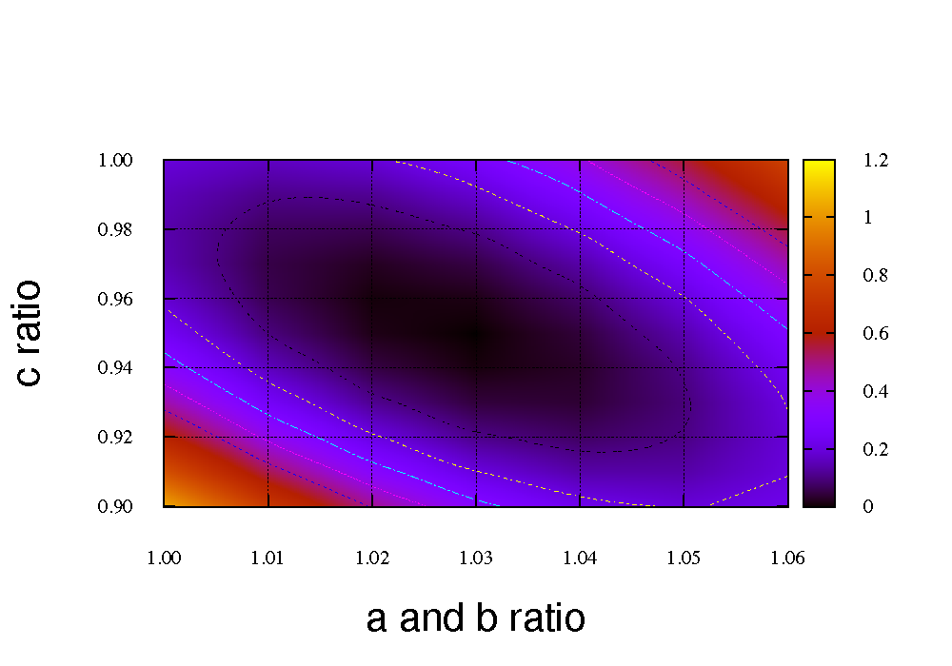
Structure property of Sb₂Te₃
Ratio | 1.0 | 1.06
a and b | 4.316 Å | 4.458 Å
c | 27.933~31.037 Å
Hexagonal cell
Rhombohedral cell
Sb6Te9 (15atom)
Sb2Te3 (5atom)

Slide 4
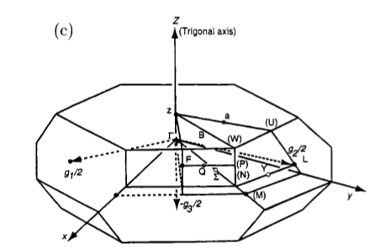
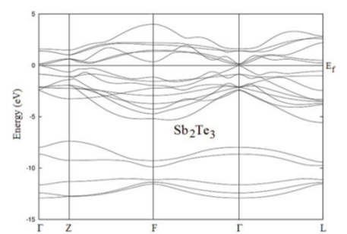
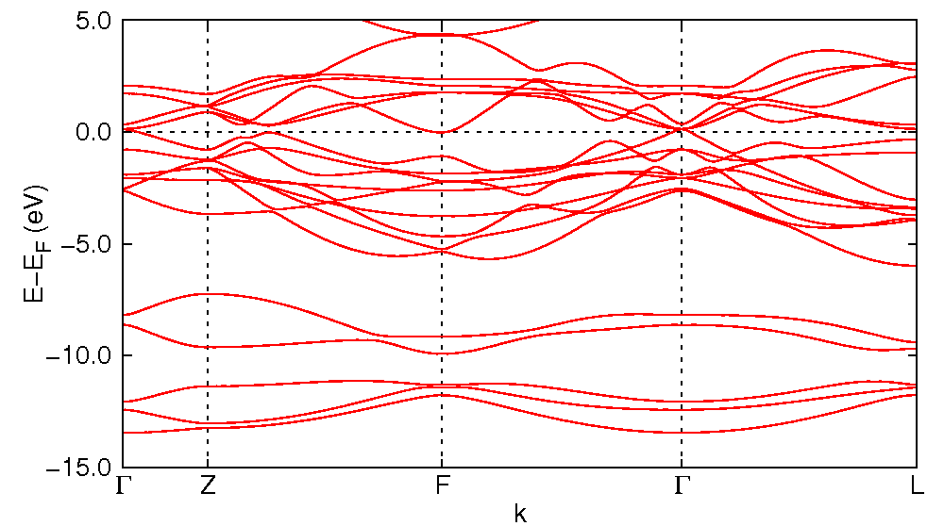
Band Structure of Sb₂Te₃ – 4d orbit (Sb) issue
Hanjin’s : 4.421 29.639
E_{hanjin} – E_{ref} = -0.565 eV
SIESTA
54 k-points (3x3x6?)
Cut-off energy = 425 Ry
LDA, DZP
Sb : 5s²5p³
without 4d orbital

Slide 5
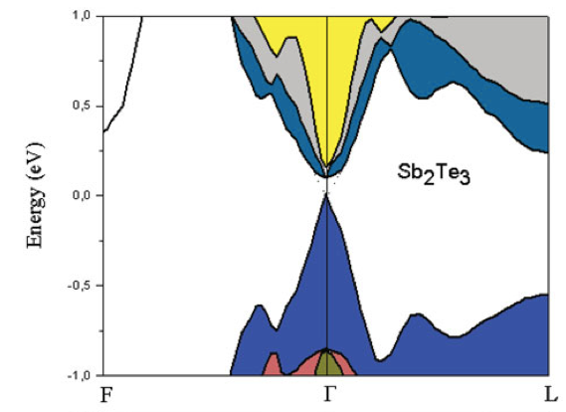
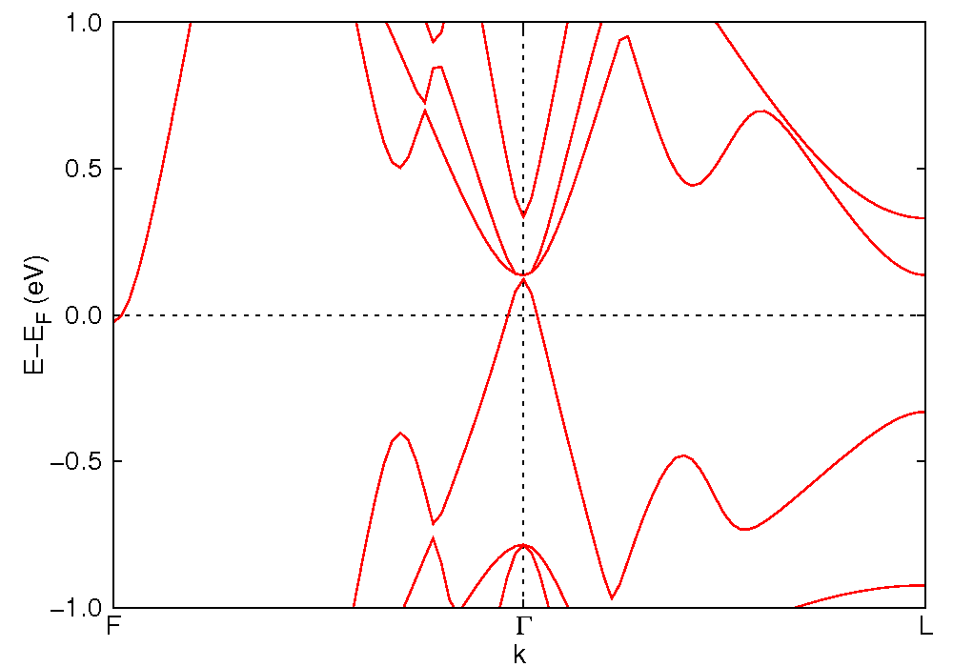
Band Structure of Sb₂Te₃ – 4d orbit (Sb) issue
Hanjin’s : 4.421 29.639
E_{hanjin} – E_{ref} = -0.565 eV
54 k-points (3x3x6?)
Cut-off energy = 425 Ry
LDA, DZP
Sb : 5s²5p³
without 4d orbital
E_{gap} = 0.093 eV

Slide 6
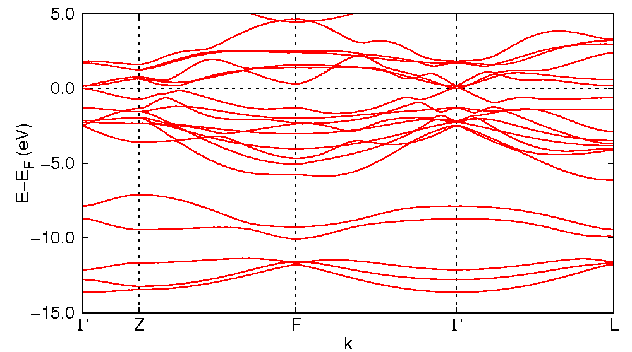
Band Structure of Sb₂Te₃ – 4d orbit (Sb) issue
Hanjin’s : 4.421 29.639
E_{hanjin} – E_{ref} = -0.565 eV
SIESTA
54 k-points (3x3x6?)
Cut-off energy = 425 Ry
LDA, DZP
Sb : 5s²5p³
with 4d orbital

Slide 7
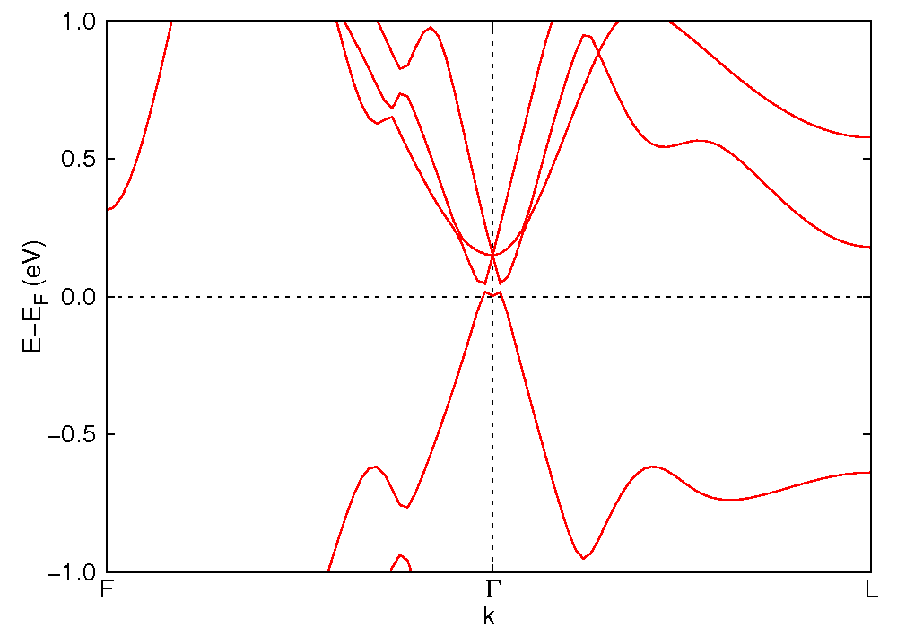
Band Structure of Sb₂Te₃ – 4d orbit (Sb) issue
Hanjin’s : 4.421 29.639
E_{hanjin} – E_{ref} = -0.565 eV
54 k-points (3x3x6?)
Cut-off energy = 425 Ry
LDA, DZP
Sb : 5s²5p³
with 4d orbital
E_{gap} = 0.093 eV

Slide 8
Band Structure of Sb₂Te₃ – 4d orbit (Sb) issue
Hanjin’s : 4.421 29.639
E_{hanjin} – E_{ref} = -0.565 eV
54 k-points (3x3x6?)
Cut-off energy = 425 Ry
LDA, DZP
Sb : 5s²5p³
without 4d orbital
with 4d orbital

Slide 9
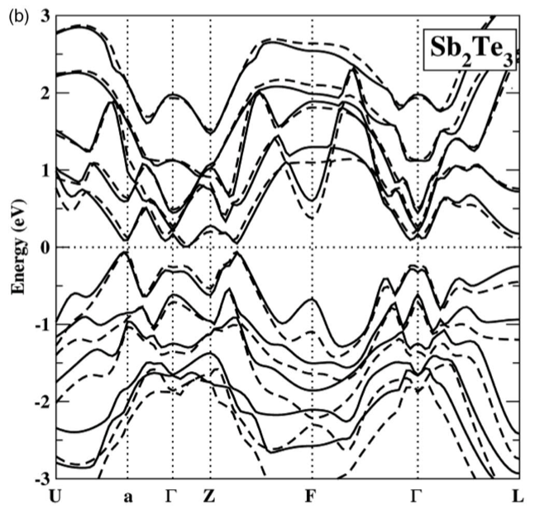
Band Structure of Sb₂Te₃ – 4d orbit (Sb) issue
Hanjin’s : 4.421 29.639
FLUER code
GGA
SOC, 60 k-points

